Slide 1
Taleo Onboarding, You Had Me at Hello

Slide 2
AGENDA
Who We Are
Our Journey
Process Overview
Advanced E-Offer
Candidate Experience
Onboarding (Transitions) Center
Behind the Scenes
Process Improvements
Q & A

Slide 3
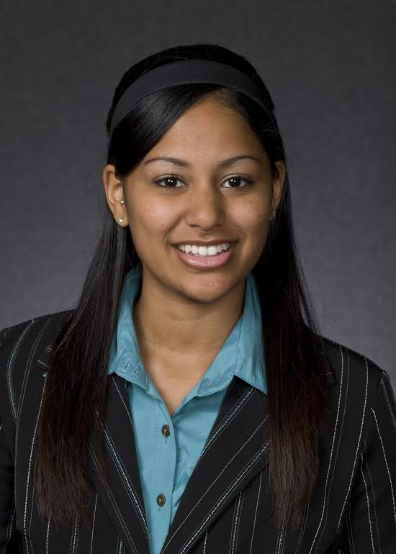
About Us
Presenter: Josh Thompson
Co-Presenter: Katrina Ricketts
10+ years combined Talent Acquisition, Taleo and Healthcare Experience
Yes, these pictures were taken 8 years ago…

Slide 4
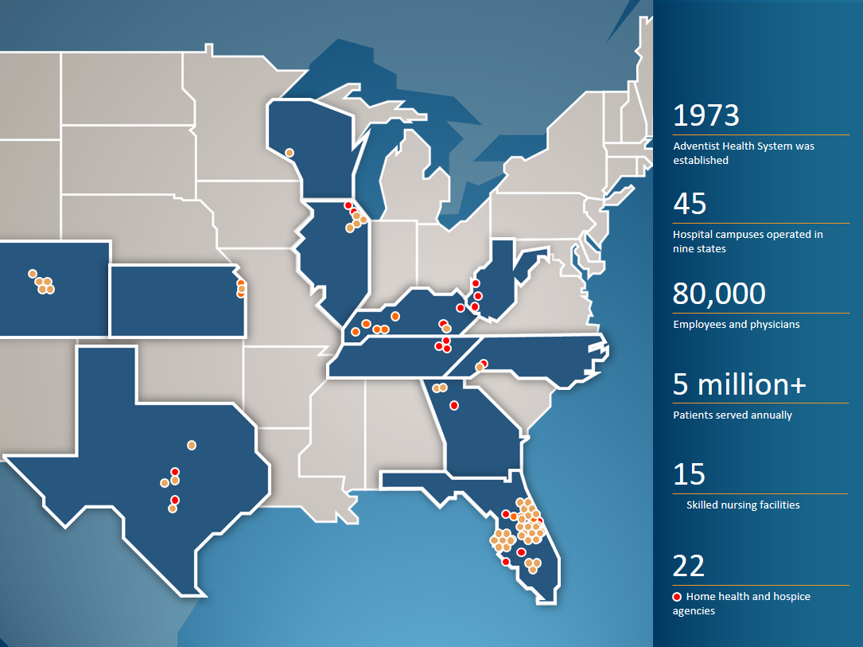
Notes:
We are a faith-based health care organization. We are headquartered in Altamonte Springs, Florida. We have more than 80,000 employees, with 45 hospital campuses and more than 8,300 licensed beds in nine states
Each Adventist Health System facility operates independently in delivering care and services to best meet the needs of the local communities they serve. While each entity is unique, all remain united in one mission: to extend the healing ministry of Christ.
Serves more than 4.7 million patients annually
These numbers provide just a glimpse of the far-reaching impact we are able to achieve by combining state-of-the-art technology with compassionate, Christ-centered care.

Slide 5
Our Journey
Groundbreaking Process
Integrated Process
Manual Process

Slide 6
Process Overview

Slide 7
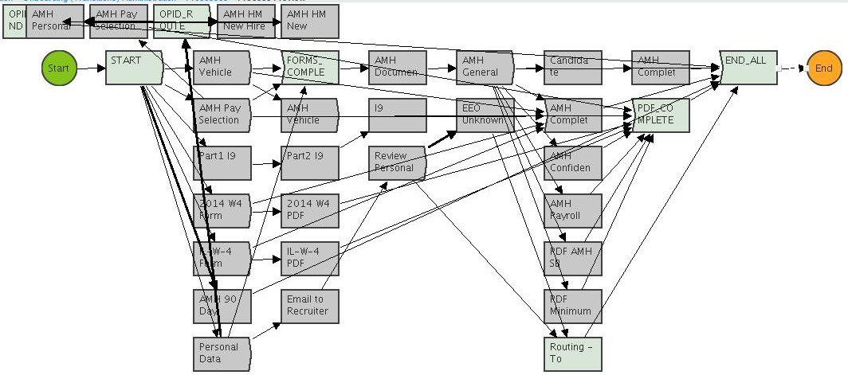
Process Overview

Slide 8
Process Overview

Slide 9
Process Overview
This is a video. Too large to upload to OHUG

Slide 10
Behind the Scenes
Documents
Adobe Acrobat
User-Defined Fields
Integrations:
Taleo Client Connect (TCC)
Vendor(s)
Reporting

Slide 11
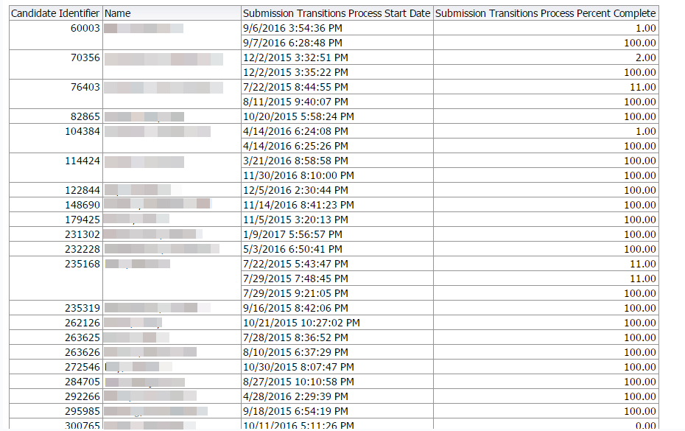
Behind the Scenes

Slide 12
Process Improvements
Our Journey (Past, Present and Future)
Challenges
Continuous Improvements
Best Practices
Talent Acquisition Partnership
Super-User

