Slide 1
The Oracle HCM Cloud Solution Library
June 9, 2017
Floyd M Teter
Sr. Director, Technical Solutions
HCM Cloud Center of Excellence

Slide 2
HCM Cloud Center of Excellence
Emerging Products and Services
Early Upgrade – Every Release
Forward Migration – Absence
HCM System Architects
Security, Integration, Data Conversion
Solution Architects
Customer Experience
Partner Enablement
Expert Technical Troubleshooting
Leading Practices and Solutions
Partner CoEs
Escalation Support
Named Customers
Tools and Technologies
Packaged Solutions
Programs
Customers
Solutions
Global Reach – Regional Delivery

Slide 3
The SaaS Lifecycle Is A Journey
Users
Usage
Grow
Features
First Use
Less Use
No Use
Start
Product Footprint
OnBoard
Fails
From “Farm, Don’t Hunt: The Definitive Guide to Customer Success” by Guy Nirapz and Fernando Pizarro

Slide 4
“First Flight” – Where Adoption Happens
First Use
Less Use
Start
OnBoard
Fails
No Use
Promoting Adoption
Better: ease of use, higher quality
Faster: standardization, automation
Cheaper: lower resource burn

Slide 5
The HCM Cloud Solution Library
Wouldn’t it be cool if you could see examples of things that work?
Enter the HCM Cloud Solution Library
A collection of example solutions known to work
Download the examples you need
Review and learn by example
Upload to your Stage instance for learning purposes
Change the data to your own configurations and upload
Using the template provided as part of the Solution Package
We support uploading via FSM (for configurations) and HLD (for data conversion)

Slide 6
What Is A Solution Package?

Slide 7
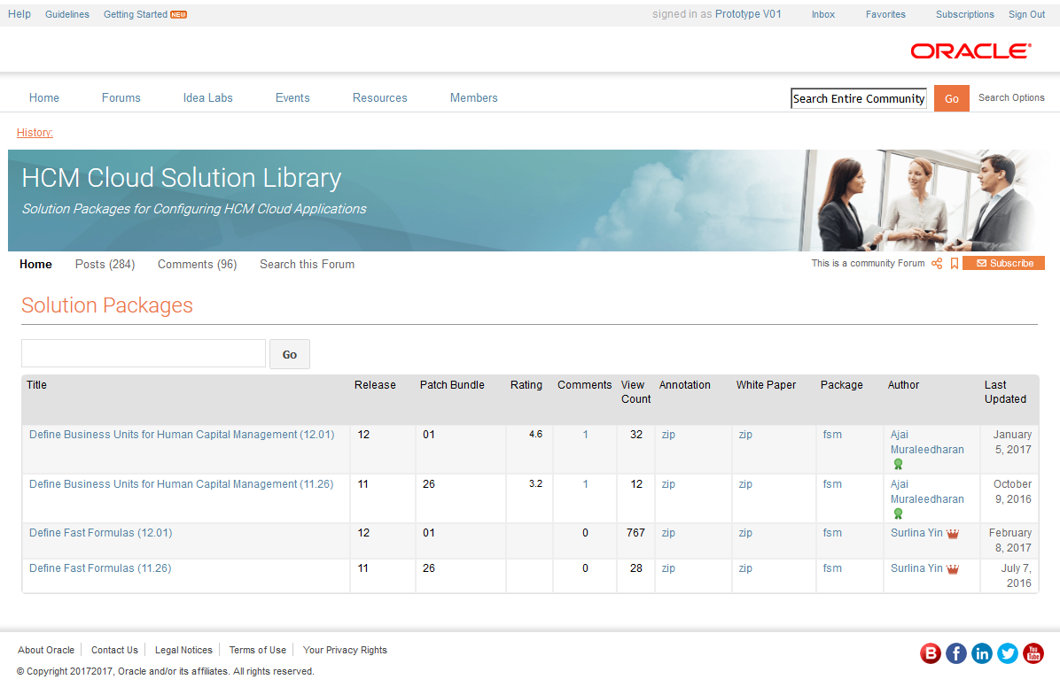
Customer Connect Page Prototype
Features:
All table columns are searchable and sortable
Users can review package specification by clicking on the package title
Users can download annotation, white paper and package zip file
Notes:
So let’s answer that question by starting at the beginning. I’m a customer or a partner looking for help. Maybe I’ll find some help in the HCM Cloud Solution Library.
I log into Oracle Cloud Customer Connect, access the HCM Cloud area, then drill down to the HCM Cloud Solution Library. And there I find a list of Solution Packages.
To find a Solution Package relevant to my particular issue, I can sort or search.
If I find something that may help, I can review the package specification by clicking on the package title.
If it looks like I’ve found something useful, I can download the Solution Package for further review – it’s a zip file.
Now let’s get down to the brass tacks…what do I get?

Slide 8
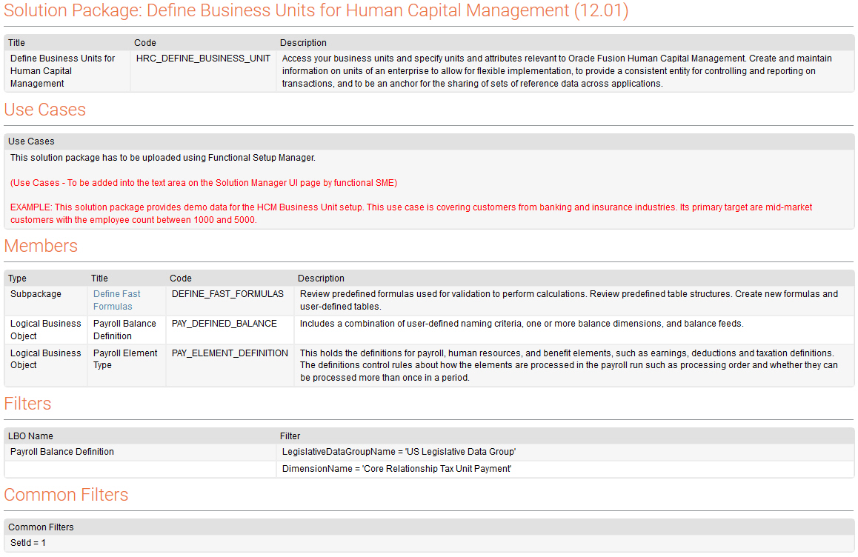
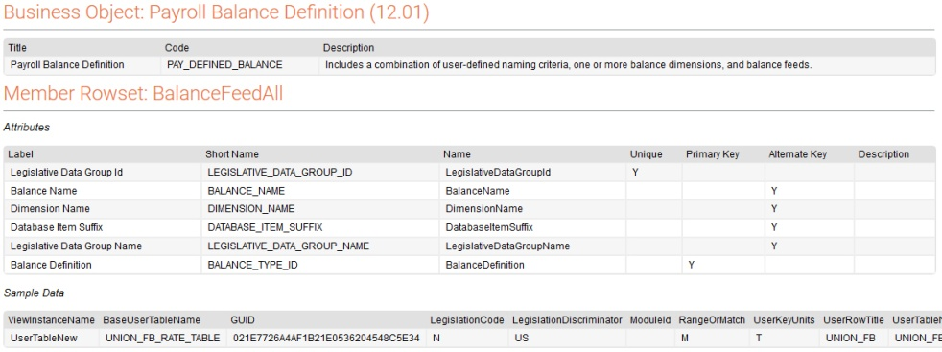
Solution Package Review - Wireframe
Solution Package detail pages contain links to the following member detail pages:
Sub-package detail pages
Business object detail pages
Index (Main) Page
Solution Package (Detail) Page
Business Object (Detail) Page
Notes:
You can see what you’re getting…either by reviewing online or reviewing after download…by reviewing the annotation provided for each Solution Package
Note that we may throw some extra goodies into a Solution Package if needed, such as additional white papers, use case examples, etc.

Slide 9
Solution Library In A Nutshell
Solution Packages
Annotated Templates
Sample Data
Checklist Instructions
Business Process Guidance
Use Guidance
Upload using supported loaders (FSM, HDL).
Browse, Select, Review
Solution Library
Oracle Cloud Customer Connect
Packages Sorted by Business Area
Your Stage or Other Test Instance
Local Storage
Share With Your Team
Upload (optional)

Slide 10
Roadmap for Solution Package Types
Talent Management
Talent Review
Performance Management
Profile Management
Absence Management
Benefits
Compensation
Payroll
Best Practice Solution Packages
Template-Based 3rd-Party Interfaces
Vertical Industry-Specific Solution Packages
Content that improves the “First Flight” experience
Customer needs and Partner contributions drive the road map
1 -2 Months
3 – 6 Months
Future Direction
Notes:
A Continually Evolving Work
Oracle-developed contributions: we’re working on these first
Curated contributions for Leading Practice solution packages from partners and customers – a community effort
Whatever improves the customer experience in “First Flight”

Slide 11
Learn More
The HCM Cloud Solution Library
https://appsconnect.oracle.com/pages/9ab032877e
Requires membership (free) in Oracle Applications Customer Connect community
The latest update via the Oracle HCM Talk Radio podcast
http://www.podcastchart.com/podcasts/hcm-talk-radio/episodes/hcm-talk-radio-hcm-cloud-solution-library-overview
Customers and Partners can reach out to engage
Collaborate on the Oracle HCM Cloud Solution Library
Provide input for the road map

Slide 12
Questions

